Slide 1
Treatment of Severe Challenging Behavior
Michael M. Mueller, Ph.D., BCBA-D, IBA
International Behavior Analysis Organization

Slide 2
Challenging Behavior
Estimates of the percentage of people with ASD who have challenging behaviors range to 85%
Estimates of severe behavior is 30-60%
Severe behavior is typically defined as people getting hurt, things getting broken, environment so disrupted as to prevent learning
This includes Self-Injurious Behaviors (SIB), Aggression, Property Destruction, and Severe Tantrums.

Slide 3
Behavioral Theory
All these kinds of behaviors are reinforced
  Positive Reinforcement
    Access to attention
    Access to preferred activities
    Access to preferred items
  Negative Reinforcement
    Escape from demands
    Escape from situations
    Escape rom people
    Escape from attention
  Automatic Reinforcement
    There is no social variable
    The behavior itself creates the reinforcement
    Internal
    Sensory

Slide 4
Behavioral Interventions
Behavioral interventions use reinforcement
The more dangerous the behavior, the more precise and certain you want to be when assessing the function!
You can use the functional reinforcer in treatment
You will understand the relationship of the treatment variables to the 4-term contingency and understand why it is working or not working

Slide 5
The 4-Term Contingency
All positively and negatively reinforced behavior complies to this
Establishing Operation, Discriminative Stimulus, Behavior, Positive Reinforcement
  EO – Sd – Bx – Sr+
Establishing Operation, Discriminative Stimulus, Behavior, Negative Reinforcement
  EO – Sd – Bx – Sr-

Slide 6
After Determine the Function of the Behavior
The results of the FA tell you the reinforcer for the behavior
They do NOT tell you how to use it or what intervention to select
How do you select?
  Let’s look at the choices
  Same options for positive or negatively reinforced behavior, but the options might be called different things and might look a little different in practice

Slide 7
General Categories of Intervention
1) Interventions that affect the EO
  These are called antecedent-based interventions
  The weaken the MO so there is less motivation or “reason” the learner might demonstrate it
    Let’s say the boy’s aggression is reinforced by access to food
    If you gave the boy small bits of food at regular intervals, the motivation to hit to get food goes away

Slide 8
General Categories of Intervention
2) Differential Reinforcement
  These interventions deliver the reinforcer under a new arrangement
  The learner still gets the reinforcer, but now gets it for something else
  Differential Reinforcement of Other Behavior (DRO)
  Differential Reinforcement of Alternative Behavior (DRA)
  Differential Reinforcement of Incompatible Behavior (DRI)
  Differential Reinforcement of Communication is referred to as “Functional Communication Training” (FCT)

Slide 9
General Categories of Intervention
3) Non-reinforcement Interventions
  Extinction
  Punishment
  Punishment is very rarely used and typically only used when reinforcement-based interventions have failed or have been exhausted
  Extinction is a component in many interventions but is rarely used on its own
  The use of punishment and extinction (by itself) require significant rationale, very serious ethical consideration, additional consent, and are last resort kinds of options

Slide 10
Antecedent Interventions
For behaviors reinforced by Positive Reinforcement
  Attention, Tangibles, Access to activities
Non-contingent Reinforcement (NCR)
  Deliver the functional reinforcer at time-based intervals (e.g., every 20 s, 5 min, etc)
  Delivery is NOT contingent on anything other than the passage of time
  Weakens the MO to reduce motivation for the behavior

Slide 11
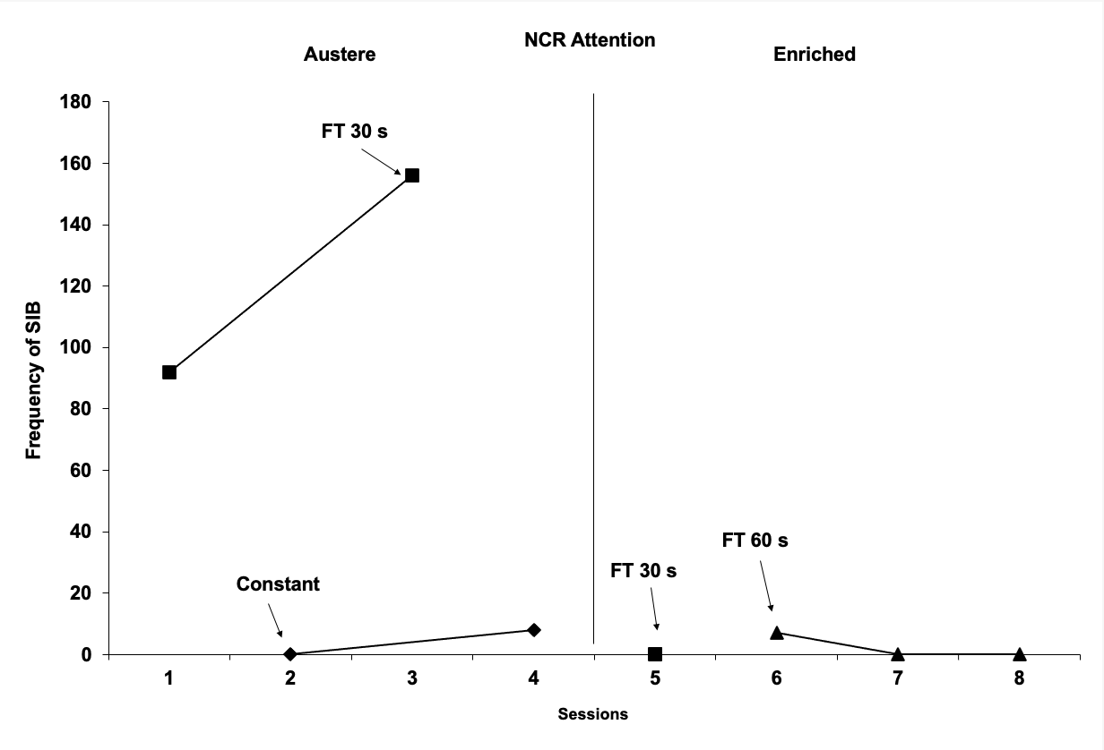
NCR

Slide 12
Antecedent Interventions
For behaviors reinforced by Negative Reinforcement
  Escape or avoidance from anything
    Typically demands to do something
Non-contingent Escape (NCE)
  Works exactly like NCR but you are delivering a break instead of attention or something tangible
  Child doing homework, you deliver frequent, regular breaks
  Lessens the build up of the MO so there is less reason to avoid work

Slide 13
Antecedent Interventions
For behaviors reinforced by Negative Reinforcement
  Deliver preferred tangibles with demands
    Lessens the aversiveness of the demand
    Has to be non-interfering with the requested behavior
  Less task aversiveness
    Slower pace
    Easier
    Given choice of some irrelevant stimuli (red or blue pen)
  Behavioral Momentum
    Hi-P, Lo-P demand sequence
Remember, all antecedent interventions occur PRIOR to the target behavior

Slide 14
Differential Reinforcement
Differential Reinforcement of Other Behavior (DRO)
  Deliver the reinforcer after some period of time without the target behavior
  Record samples of the behavior
  Determine average inter-response time (IRT)
  Set initial interval just inside this IRT
  If no behavior in the interval, deliver reinforcer
  If behavior in the interval, reset the interval
  Increase the interval duration over time

Slide 15
Differential Reinforcement
Differential Reinforcement of Alternative Behavior (DRA)
  Very popular and very easy to implement
  Chose a different (appropriate) behavior
    Completing a math problem
    Compliance
  When this new “alternative” behavior is demonstrated, you deliver the reinforcer
  You do not deliver the reinforcer anymore for the target behavior
  Child still gets the reinforcer, but for a new behavior, not the challenging behavior

Slide 16
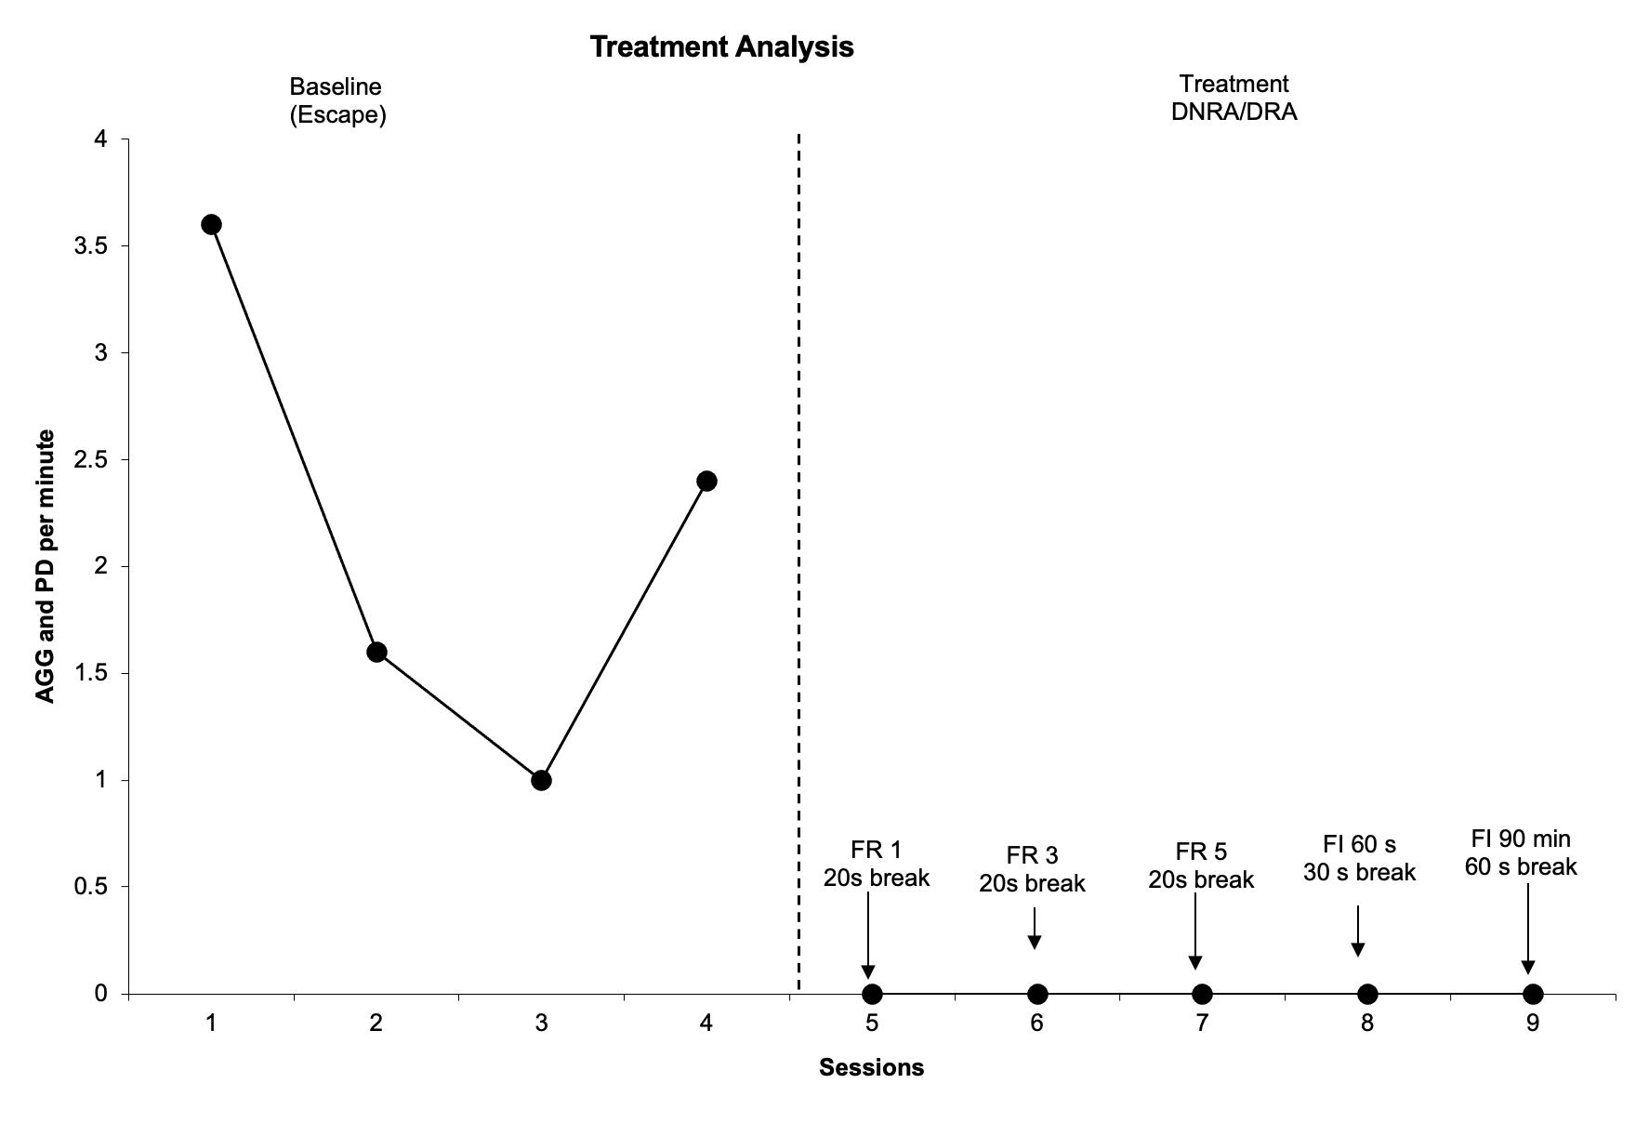
DRA

Slide 17
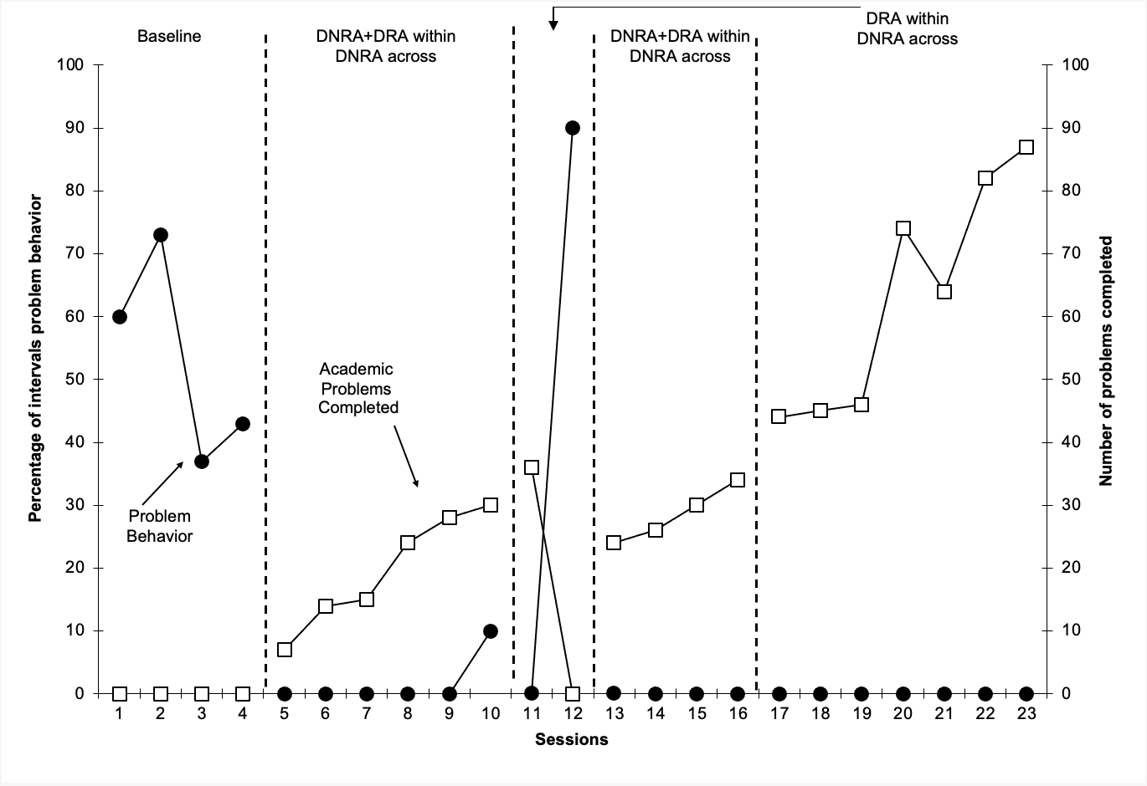
DRA

Slide 18
Differential Reinforcement
Differential Reinforcement of Incompatible Behavior (DRI)
  Works exactly like DRA but the behavior to be reinforced needs to be physically incompatible with the target behavior
    Cannot by physically possible to demonstrate both behaviors at the same time
    Hitting head, sitting on hands
    Pinching peer, hands on desk
Behavior shifts in the direction of reinforcement
  Hitting no longer gets reinforced, having hands on desk does
  Hands on desk will persist and hitting will decrease

Slide 19
Functional Communication Training
This is differential Reinforcement of Communication
  Works like DRA and DRI but the behavior to reinforce must be communicative
  Spoken word, sign, card exchange, device press, etc.
  Teach the new behavior
  Physically force the exchange of communication
  Follow the communication with reinforcer delivery
  Make sure the response is mastered and then only provide reinforcement for the new response

Slide 20
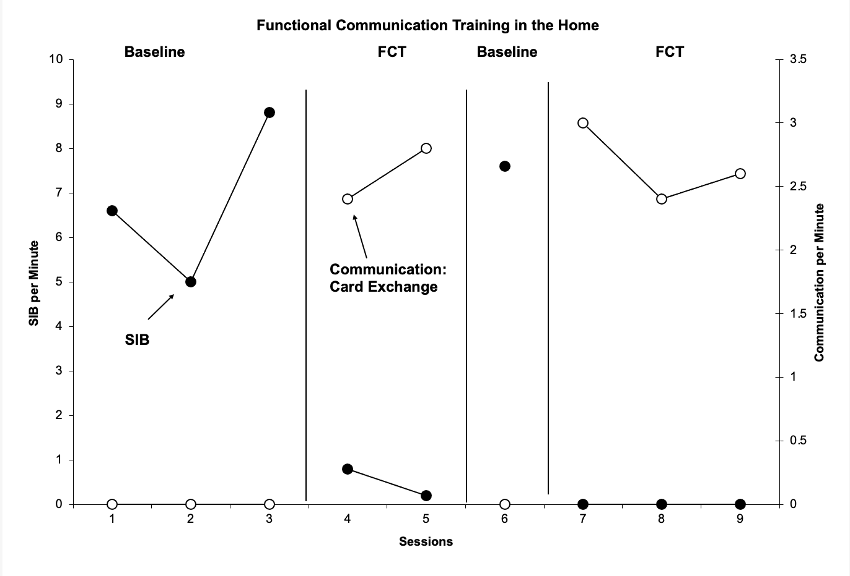
FCT

Slide 21
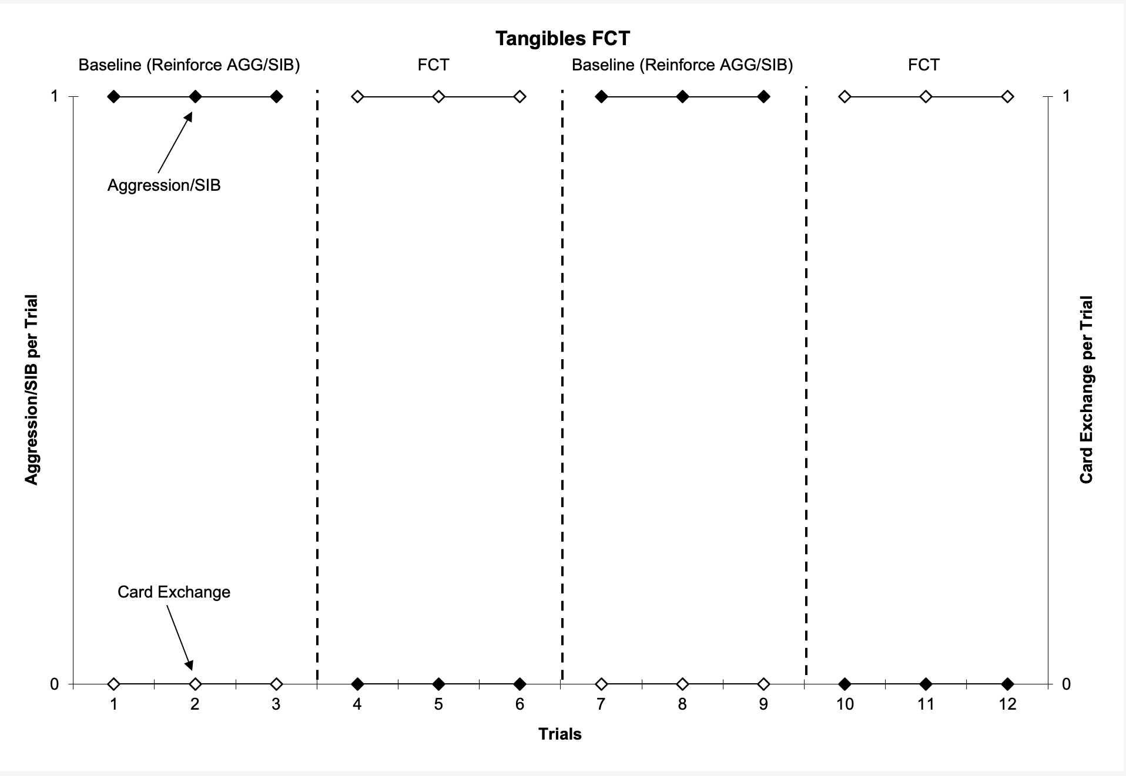
FCT

Slide 22
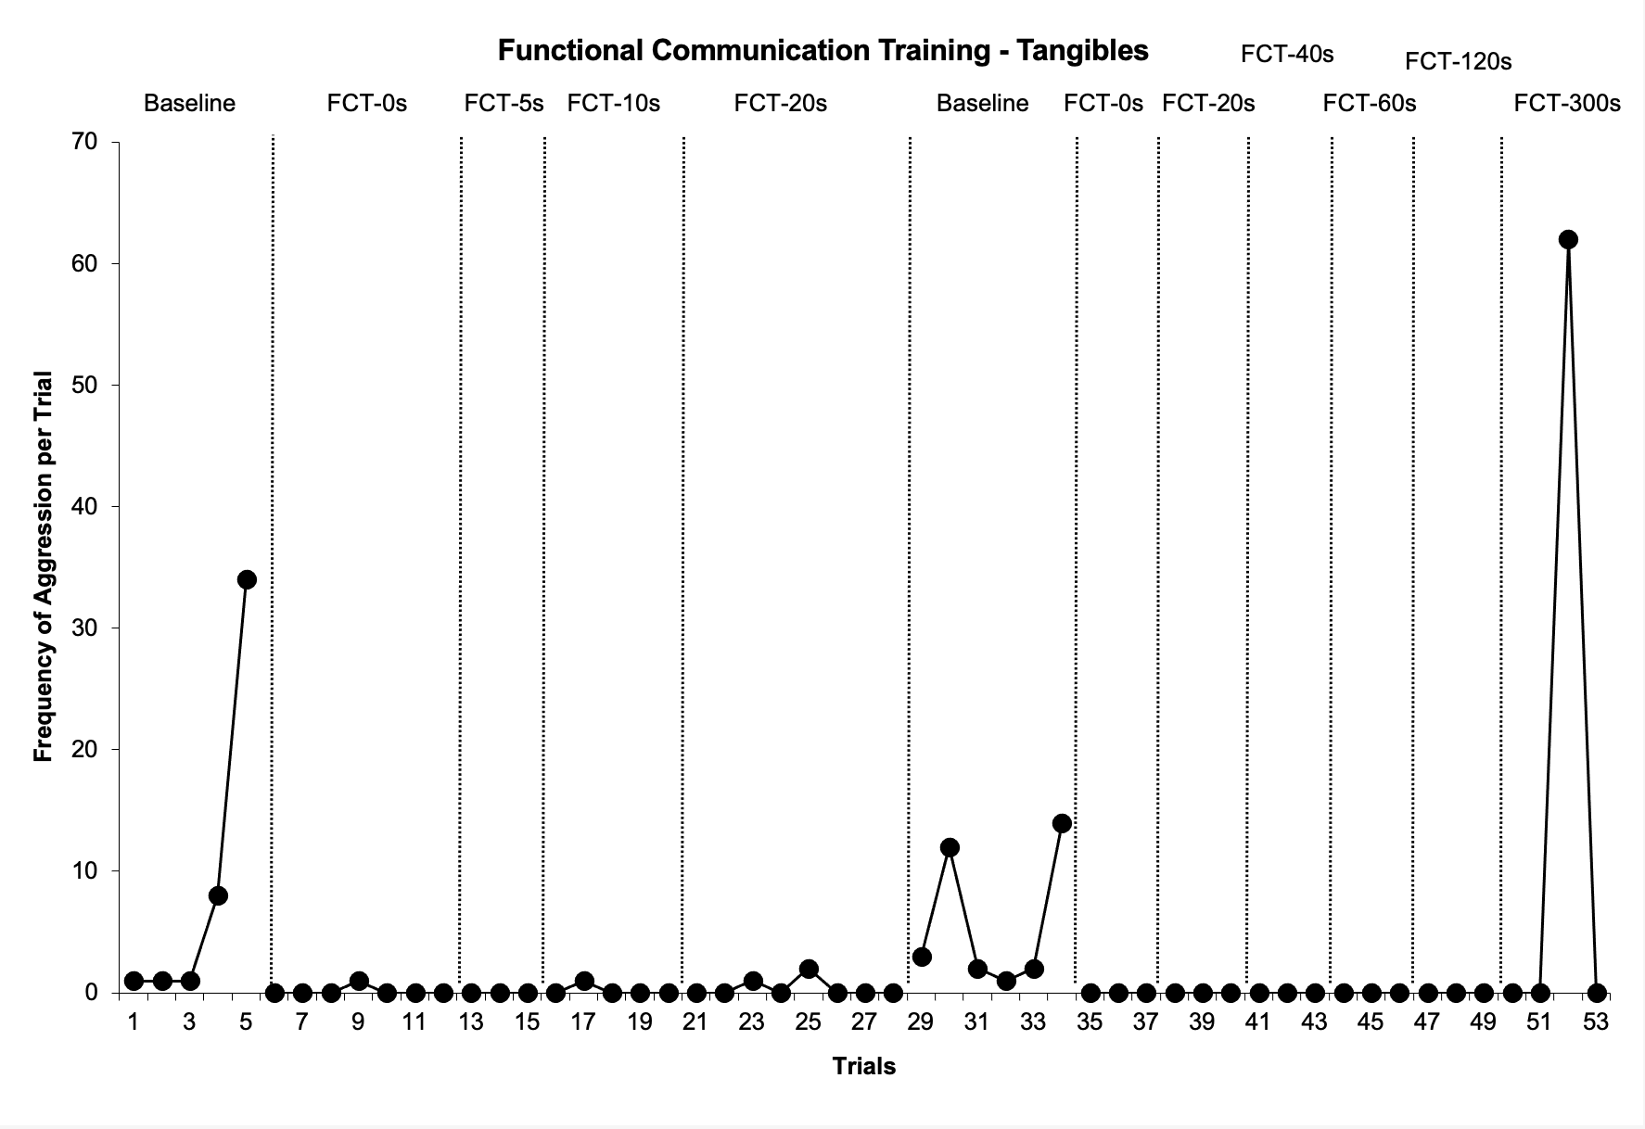
FCT

Slide 23
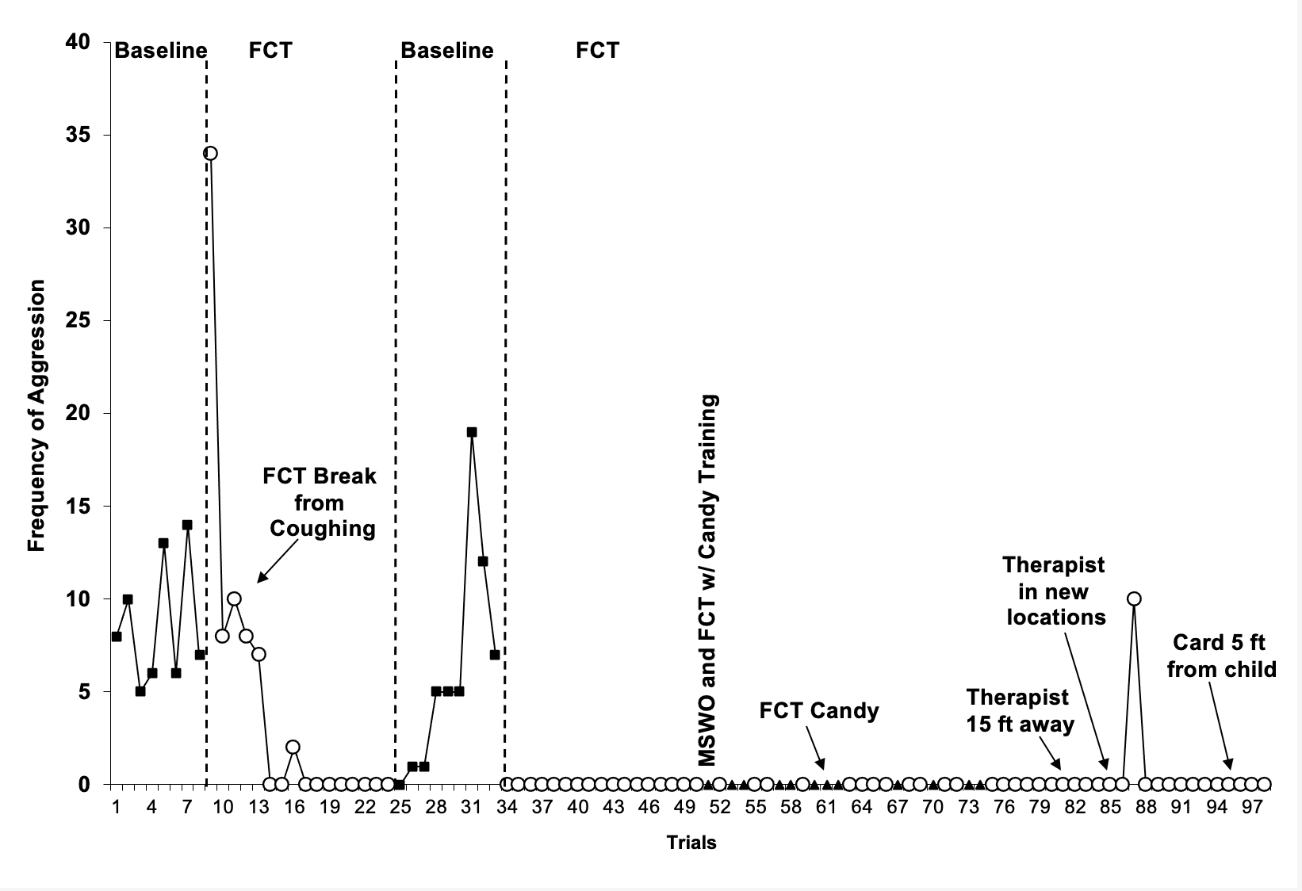
FCT to Escape Coughing

Slide 24
Suggestions to Help Selection
If communication is done with card exchange, device, or sign
  Use FCT
Tangibles
  Use FCT
Attention
  NCR, DRA, DRI, DRO
Escape
  Antecedent modifications, DNRA, FCT

Slide 25
Finally
Make sure you identify the function
  You will know the 4-term contingency and be able to place the behavior and the interventions in their proper place
  You will be able to explain the success or failure
  Choose an intervention
  Test it
  Keep it if it is working, try another if it is not

Slide 26
Thank You!
Question?
Michael Mueller, Ph.D., BCBA-D, IBA
mmueller@theibao.com

