Slide 1
Assessment of Severe Challenging Behavior
Michael M. Mueller, Ph.D., BCBA-D, IBA
International Behavior Analysis Organization

Slide 2
Challenging Behavior
Estimates of the percentage of people with ASD who have challenging behaviors range to 85%
Estimates of severe behavior is 30-60%
Severe behavior is typically defined as people getting hurt, things getting broken, environment so disrupted as to prevent learning
This includes Self-Injurious Behaviors (SIB), Aggression, Property Destruction, and Severe Tantrums.

Slide 3
Self-Injurious Behavior
Head banging
Head hitting
  Punching or slapping
Self biting
Hair pulling
Eye gouging

Slide 4
Aggression
Directed to others
Hitting
  Punching, slapping
Kicking
Pulling hair
Biting

Slide 5
Property Destruction
Breaking toys
Breaking furniture
Throwing materials
Punching or kicking holes in walls
Tearing or shredding papers

Slide 6
Behavior Assessment
Since the mid-1990s, behavioral assessment has relied on the identification of the reinforcer
“Function” means the same things as “Reinforcer”
Functional Behavior Assessment (FBA) identifies the function (reinforcer) for a behavior
Why is this important?

Slide 7
Behavioral Theory
All these kinds of behaviors are reinforced
  Positive Reinforcement
    Access to attention
    Access to preferred activities
    Access to preferred items
  Negative Reinforcement
    Escape from demands
    Escape from situations
    Escape rom people
    Escape from attention
  Automatic Reinforcement
    There is no social variable
    The behavior itself creates the reinforcement
    Internal
    Sensory

Slide 8
Behavioral Interventions
Behavioral interventions use reinforcement
If you do not identify the reinforcer for the dangerous behavior, you could end up accidentally reinforcing it and making it worse, when your goal is to reduce it.
  Time out example
  If a behavior is reinforced by escaping demands
    Teacher delivers an academic request and student hits himself
    Teacher removes the student from the academic setting
    Teacher is delivering the reinforcer (escape) when she delivers the time out.
    This will increase the probability of this behavior occurring again in that situation in the future
The more dangerous the behavior, the more precise and certain you want to be when assessing the function!

Slide 9
The 4-Term Contingency
All positively and negatively reinforced behavior complies to this
Establishing Operation, Discriminative Stimulus, Behavior, Positive Reinforcement
  EO – Sd – Bx – Sr+
Establishing Operation, Discriminative Stimulus, Behavior, Negative Reinforcement
  EO – Sd – Bx – Sr-

Slide 10
The 4-Term Contingency
Think of functional assessment as a puzzle to be solved
  There are 4 pieces
  We know one of them (the target behavior)
  We need to know all of them to fully understand the behavior
  How do we determine the others?
    Identify the reinforcer and others become known in the process
    Functional analysis identifies the reinforcer.
Bx
EO
Sd
Bx
Sr+

Slide 11
FBA
Indirect
  Interview others
  Rating scales
Direct
  ABC observation
  Narrative observations
Functional Analysis

Slide 12
Descriptive Methods
The purpose of all descriptive methods should be to inform the functional analysis
No descriptive methods alone or in combination should be used as the means to derive function
  There are some exceptions
    Medical fragility, client safety (beyond some already occurring baseline level)
No interview or other indirect or descriptive methods are reliable or valid
  ALL of these methods are attempted shortcuts that have failed to produce desired results.

Slide 13
If there is a behavior to be analyzed…
It is already being reinforced
It is happening persistently enough to lead to a referral for professional assistance
It will continue to happen if left unchanged
It is dangerous, disruptive, harmful

Slide 14
Functional Analysis
Natural environment has multiple consequences occurring simultaneously and observation alone cannot tease these apart.
  Observations are limited and this is why there a point of diminishing returns
    Once you see these multiple situations, those individual variables become possible reinforcers
Arrange simple test and control situations called “conditions”
  Test conditions provide a possible reinforcer contingently
  Control conditions provide the possible reinforcer noncontingently
Each test condition is made up of a potential EO, antecedent stimuli, and consequences for the behavior in each condition
Compare the amount of target behaviors across conditions

Slide 15
Functional Analysis
We are re-creating situations that currently contain the target behavior in the referral environment
  We are not making up novel situations!
  These are currently ongoing situations that are confounded by multiple potential reinforcers
The conditions we run are the exact same situations that are currently being “run” in the the referral environment

Slide 16
Functions of Problem Behavior
Attention
Access (to Materials or Activities)
Escape
Automatic Sources

Slide 17
Attention
Attention
  Teachers and school personnel often respond to problem behavior with reprimands, response interruption, comfort etc
  Attention may reinforce student problem behavior (Thomas et. al., 1968)

Slide 18
Access
Access to Materials or Activities
  Teachers, school personnel, and other students often respond to problem behavior by giving the student tangible items or access to a preferred activity
  Aberrant behavior may be positively reinforced by access to materials or activities that a student wants (Iwata, et al., 1982; Patterson et. al., 1987)

Slide 19
Escape
Escape-Avoidance of Aversive Demand Conditions
  Problem behavior in schools are often responded to by removing task demands/aversive conditions from the student
  Removal of task demands/aversive conditions may negatively reinforce aberrant behavior (Carr et. al., 1980)

Slide 20
Automatic
Sensory and Perceptual Consequences
  Aberrant behavior may persist independent of social consequences found in school settings
  Aberrant behavior may be positively or negatively reinforced by perceptual and sensory consequences produced by the behavior itself (Iwata, et al., 1982)

Slide 21
What are the Possible Reinforcers?
Positive Reinforcers
  Attention delivered by people
  Tangibles
Negative Reinforcers
  Breaks from things
  Escape from things
Automatic Reinforcers
  Access to internal stimulation
  Breaks from internal stimulation

Slide 22
How Do We Test These?
Create a possible deprivation situation to test positive reinforcers
  Attention (ignore)
  Tangibles (remove)
Create a potentially aversive situation to test negative reinforcers
  Task demands (present)
  Sensory situation (present)
Leave by self, ignore, do not interact with to test for automatic
NEED some control condition

Slide 23
The Logic
Positive Reinforcers
  Withhold or restrict access to a possible reinforcer
  Present access to the possible reinforcer contingent on target behavior
  Control condition provides noncontingent access
Negative Reinforcers
  Present the aversive event/stimuli
  Remove contingent on target behavior
  Control condition does NOT present the aversive event/stimuli
If the behavior is high when the reinforcer is contingent and low when the reinforcer is provided non-contingently, this is a test that the behavior is reinforced by that stimuli.

Slide 24
The Logic
The analysis needs both parts
  We need to show that the behavior is high when the reinforcer follows it
  We need to show that the behavior is low or absent when that same reinforcer is freely available
If I am hitting to get a drink of water, I should not hit when I have free access to water
If I am hitting to escape from work, I should not hit if there is no work
If I am hitting to get access to my toys, I should not hit if I have access to my toys

Slide 25
Dynamic?
You test only the possible reinforcers from your indirect or direct assessment
  Not the same list of conditions for everyone
You use the specific parameters or types of stimuli relevant to the situation in your conditions
  Type of attention, type of demands, tone of voice, other variable
  Make this as close to the referral environment as possible
This could be one single pair-wise analysis or could include 6-7 conditions
Base the duration of the conditions on the situation
  Good observational data, shorter conditions
  Change from short-duration to longer-duration if no behavior

Slide 26
Basic Arrangements
Attention
Tangibles
Escape from Demands
Alone/Ignore
Control

Slide 27
Attention Condition
No materials
  Less risk of affecting EO
“I have to read” type statement
Attention is reprimanded unless observations suggest use of a different form of attention. Let observations guide this.

Slide 28
Escape
Academic or other difficult task
3-prompt procedure
Each occurrence of target behavior: Therapist removes task and attention for 10-30 s depending on legth f session and other SR+ intervals
Re-present task demand after the escape period times out

Slide 29
Escape
Tasks from teacher/parent
  Difficult
  Previously associated with TB
Low level Praise if teachers observed using it in class
  Only for V
  Not for M or P
10-15s break on 5 min conditions

Slide 30
Tangibles
Identify preferred stimulus
Allow child to engage for short period and then restrict
If target behavior, allow access to item for 30 s
  10-3- depending on session length and other SR+ intervals)

Slide 31
Tangibles
1-2 minute access
Physically remove the item
NO ATTENTION
Return item for 10-15s (5 min conditions)
Restrict item again

Slide 32
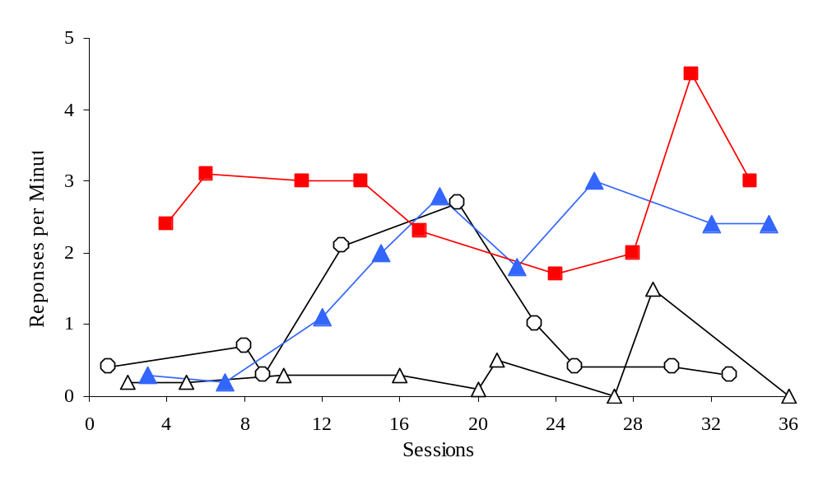
Attention and Tangibles
Attention
Tangible
Play
Demand

Slide 33
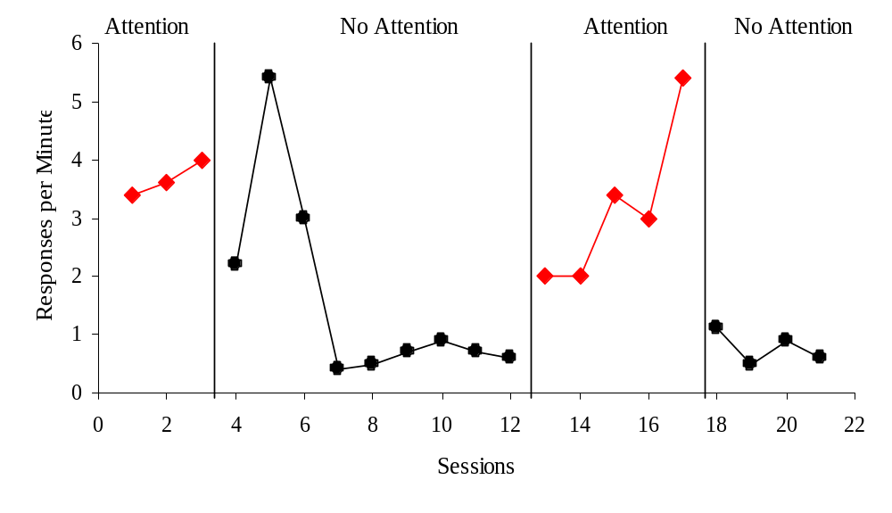
Attention in Tangibles Condition

Slide 34
Confounding of Attention and Tangibles
Falsely identified two reinforcers when it was only attention that just so happened to be delivered in the tangible condition
Good example of why proper identification of specific SR+ is important
  This was NOT a “synthesized” reinforcer
Also highlights the sensitivity of some dangerous behaviors to very low levels of attention

Slide 35
Alone
Child left completely alone for the condition
If high levels of target behavior occur in this condition over time: Automatic Reinforcement
No socially mediated consequences
Reinforcement derives from the behavior itself, not extrinsic

Slide 36
Alone
Similar
  “Ignore”
    Therapist present
  “No interaction”
    Therapist present
Are used as test for automatic reinforcement
  Extinction burst when attention is removed?
  Extended alone
    Auto-consistent rates
    Extinction-decreasing rates

Slide 37
Control
Provide noncontingent access to anything being tested as a reinforcer
The logic of the analysis requires a control
The logic of the analysis requires
  Contingent access in the test condition
  Noncontingent access in the control

Slide 38
Control
Noncontingent access to any reinforcer from a test condition
Constant or near constant attention
Free access to tangibles
Free access to activities from interrupt
No demands

Slide 39
When is Analysis Finished?
If all are elevated*
If all are low*
  *This should also trigger re-examination of other data
Re-evaluate descriptive data, run a new analysis
Lengthen condition durations

Slide 40
How Do You Know When the Analysis is Finished?
Determining separation can be subjective
Identification of function can be subjective
Some are easier than others
Good descriptive data, clearer results?

Slide 41
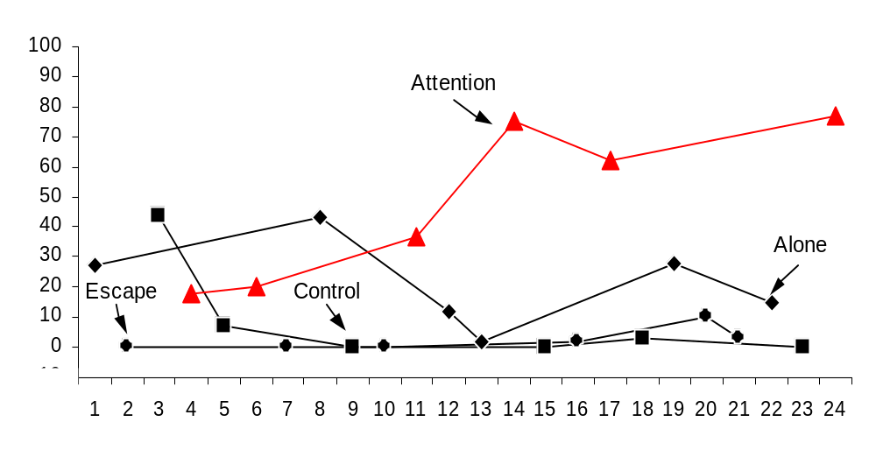
Attention
Percentage of intervals
Sessions

Slide 42
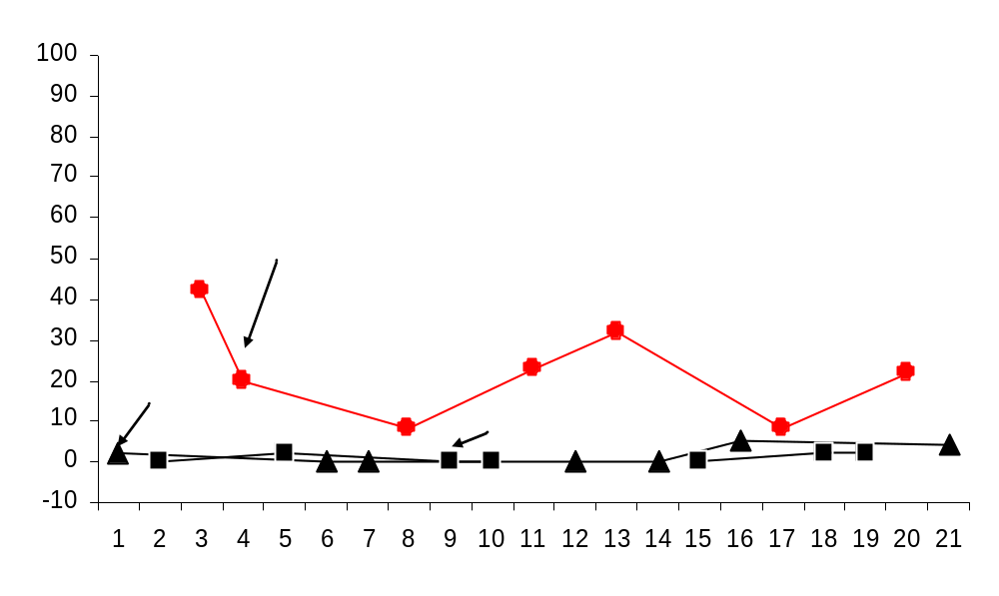
Escape
Percentage of intervals
Sessions

Slide 43
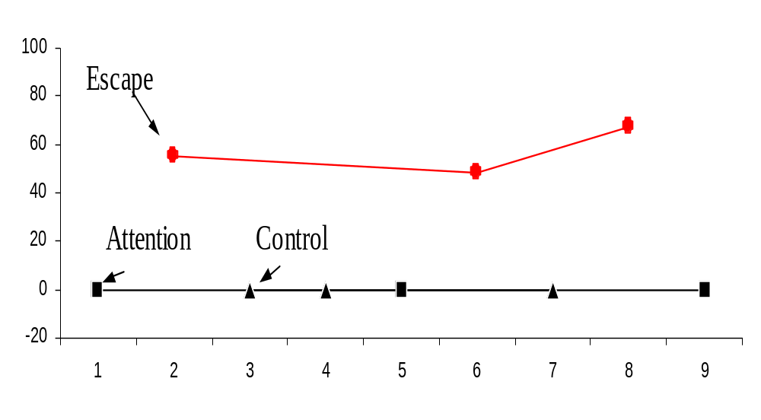
Escape
Percentage of intervals
Sessions

Slide 44
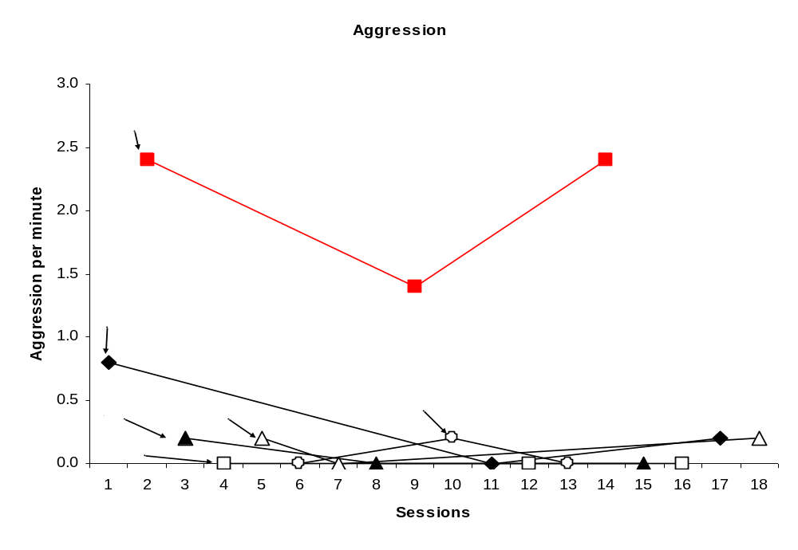
Escape

Slide 45
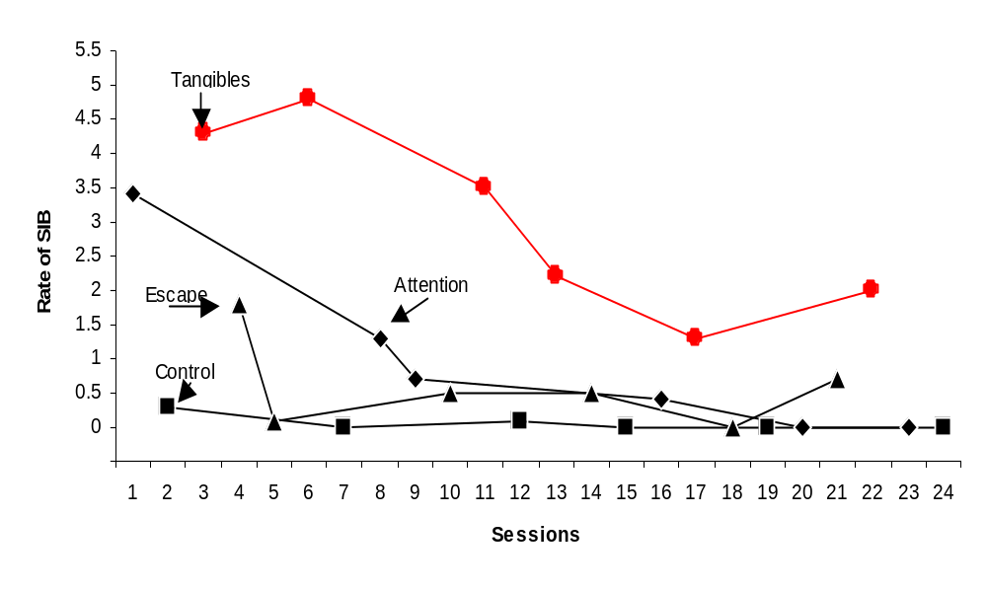
Tangibles
SIB per minute

Slide 46
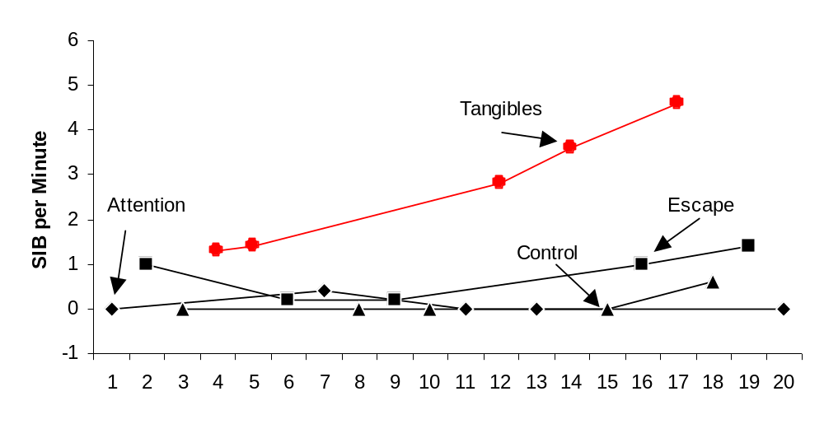
Tangibles

Slide 47
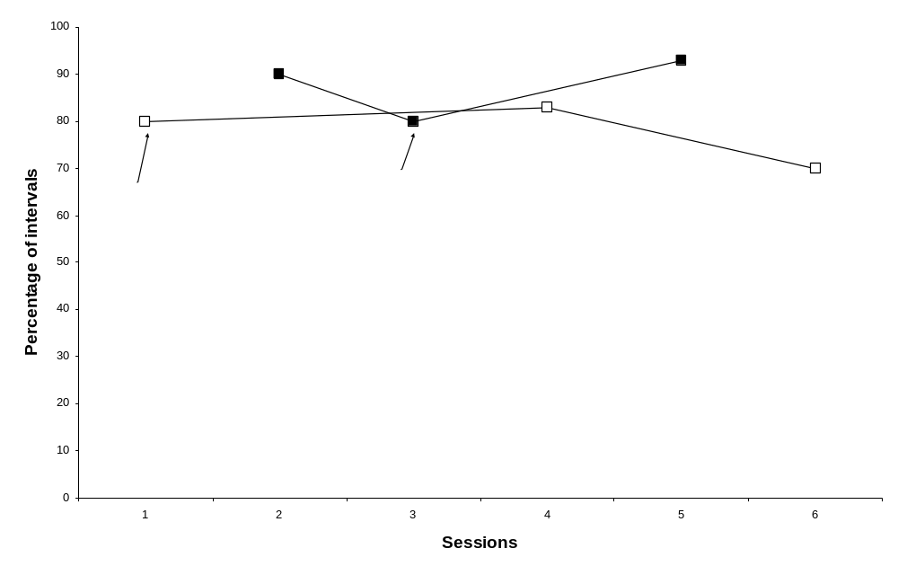
Automatic

Slide 48
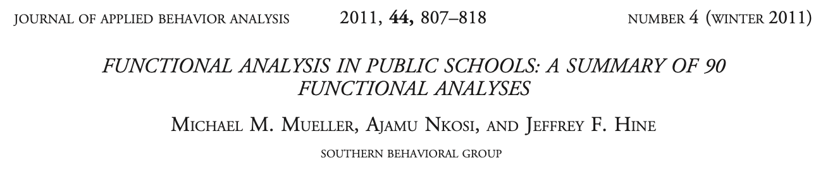

Slide 49
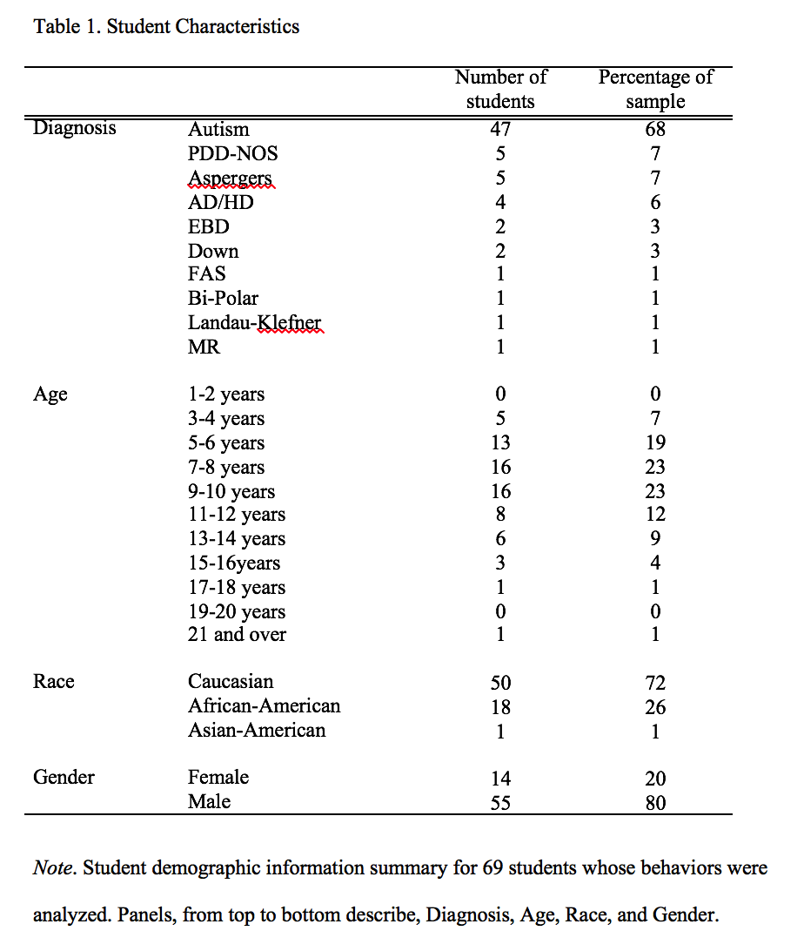

Slide 51
64% contain 4 or fewer conditions
84% used 5-minute sessions or under
70% 2 hours or less
82% % 3 hours or less

Slide 52
Previous Data
Iwata et al 1994
  5% of 152 analyses multiple control
Kurtz et al 2003
  7% of 30 analyses multiple control
Hanley et al. 2003
  14.6% of 536 analyses multiple control
Mueller et al 2011
  18% of 90 analyses multiple control
  This is 102 analyses out of 808 analyses (12.6%) that contained multiple control of a behavior- not synthesized, more than one individual reinforcer.

Slide 53
Thank You!
Question?
Michael Mueller, Ph.D., BCBA-D, IBA
mmueller@theibao.com

