Slide 1
Applied Behavior Analysis
Michael M. Mueller, Ph.D., BCBA-D, IBA
Executive Director of the International Behavior Analysis Organization (IBAO)

Slide 2
My Background
Practicing in ABA 25 years
BCBA 22 years ago
2005 Southern Behavioral Group
2009 Stimulus Publications
2020 International Behavior Analysis Organization (IBAO)
  Importance of certifications for community and providers

Slide 3
What is Applied Behavior Analysis (ABA)?
Behavior Analysis
  The study of behavior for its own right – simply to understand what affects behavior in various ways
  Not relating to the improvement of any social conditions
  Referred to as “Basic” research
  Led to the understanding of certain key concepts in behavioral theory
    Discriminative Stimuli
    Motivating Operations
    Reinforcement
    Punishment
    Extinction
  Animal and Human studies

Slide 4
What is Applied Behavior Analysis (ABA)?
Applied Behavior Analysis
  The application of “Basic” behavioral principles to problems of social significance
  “Social significance” refers to issues that positively impact people
  People of all ages. People in all settings and walks of life. In society in general
  Because we know what make behavior increase or decrease, we can increase behaviors we want to see more of and decrease behavior we want to see less of

Slide 5
The General Approach to Behavior Change
Since the 1930/40s, we have known about the concepts of Positive Reinforcement
  If a behavior is followed by something pleasant, that behavior is likely to occur again in the same situation
  Behaviors that do not led to these pleasant consequences are not likely to be repeated
  A girl says “cookie” and is given a cookie. When she wants a cookie, she will be more likely to say “Cookie”
  Behavior change is based on the consequences of the behavior

Slide 6
The General Approach to Behavior Change
Since the 1930/40s, we have known about the concepts of Negative Reinforcement
  If a behavior removes something unpleasant, that behavior is likely to occur again in the same situation
  Behaviors that do not led to this removal are not repeated
  Someone is too hot. They press the “On” button on the A/C and the hot feeling goes away. Next time they are too hot, they will again press the “On” button
  Behavior is changed based its consequences

Slide 7
The General Approach to Behavior Change
If a behavior has been reinforced and then reinforcement is withheld, the behavior will stop too
  Extinction
These are reliable and predicable findings through 50 years of research across dozens of species and humans.
In the late 1960s, researchers decided to apply these concepts and techniques to real world concerns.
  The concern 50 years ago, as it is today, is to use this science to help to make the world a better place!

Slide 8
Problems of Social Significance
Work production in organizations
Occupational safety
Psychological and mental health issues
Academic achievement
Life skills/Functional skills/Skills of daily living
Social skills
Making friends
Speech and Language
Feeding and eating issues
Sports
Challenging behavior

Slide 9
Autism
Even though ABA has impact on all facets of life, ABA has long been associated with the treatment of issues related to learners with Autism
As Autism Spectrum Disorder is defined by behavioral characteristics:
  Language issues
  Social issues
  Behavioral challenges
ABA is a natural fit as an evidenced based approach to change behavior.
  ASD is behavioral excesses and deficits
  ABA can reduce and increase behavior

Slide 10
In General, How does it Work?
Skill Acquisition
  We know that when reinforcement follows correct responding, it will increase those responses
  Conduct a preference assessment to find reinforcers
  Conduct a skills assessment
    Language, communication, concepts, social skills, play, functional skills, safety, academics, etc.
  Determine what skills are in deficit and a priority for learning
  Break skills into smaller steps
    Hand washing
      Turn on water, wet hands, pump soap, scrub hands, rinse, turn off water, etc.

Slide 11
Skill Acquisition
The Behavioral Therapist (IBT) presents an instruction
  Correct responses are followed by reinforcement
  Incorrect responses are followed by teaching
    Prompts, assistance, guidance and the re-delivery of the instruction
  Little fragments of larger behaviors can be learned rather quickly, and they add to each other and the learner masters larger skills
  The ABA approach relies on the collection of data in order to analyze progress
    Data
    Graphs
    Analysis
      Continue or make changes?

Slide 12
Skill Acquisition
Most ABA instructional strategies teach skills in “discrete” learning opportunities referred to as “trials”
  Each trial is an opportunity to demonstrate the appropriate skill being taught
Data collection in this context often looks at the number of trials that the correct skill was demonstrated relative to the total number of trials where that skill was taught
  Correct trials/total trials = % of correct trials
  Develop mastery criteria
    Asks, “What will the learner need to do to convince us this skill was mastered?”
      %, days or sessions, people, setting

Slide 13
Skill Acquisition
Graph and analyze the data on a day-to-day basis
  Increasing trend, flat, decreasing, etc.
Increasing trend means the learner is acquiring the skill (learning)
Flat trend means the learner is not acquiring the skill (not learning)
Decreasing trend means the learner is demonstrating less of a behavior
  This is good news in behavior reduction
  Not so good if we are trying to teach a new skills

Slide 14
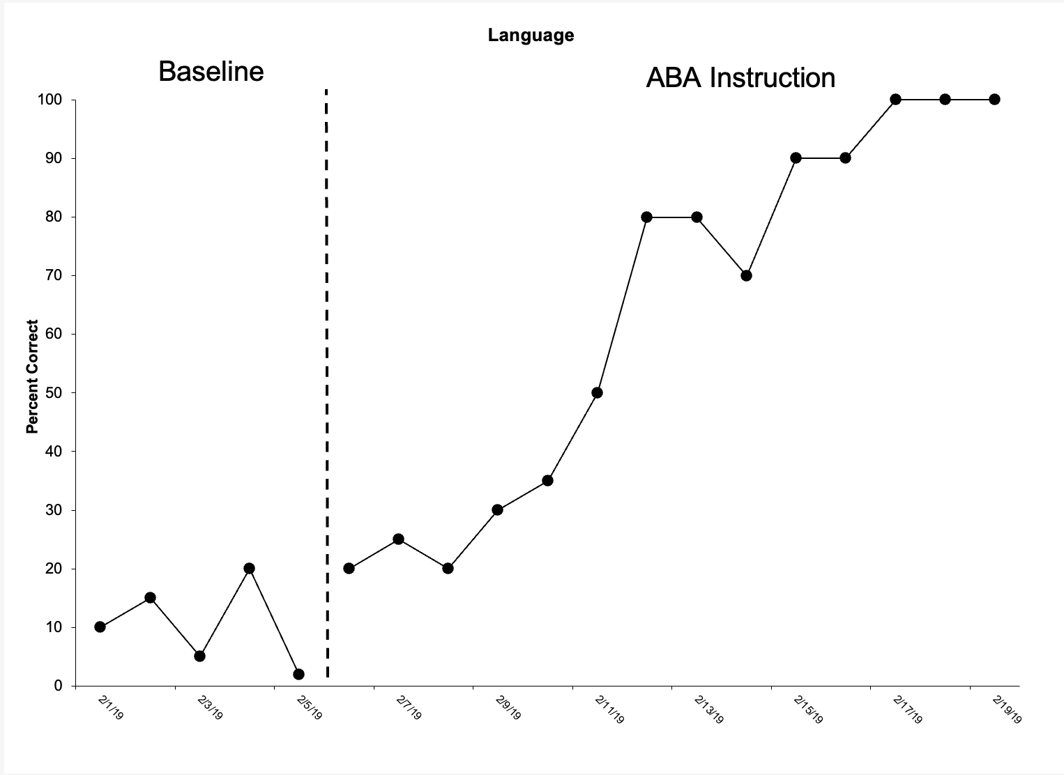
Data Examples

Slide 15
Data Examples

Slide 16
Data Examples

Slide 17
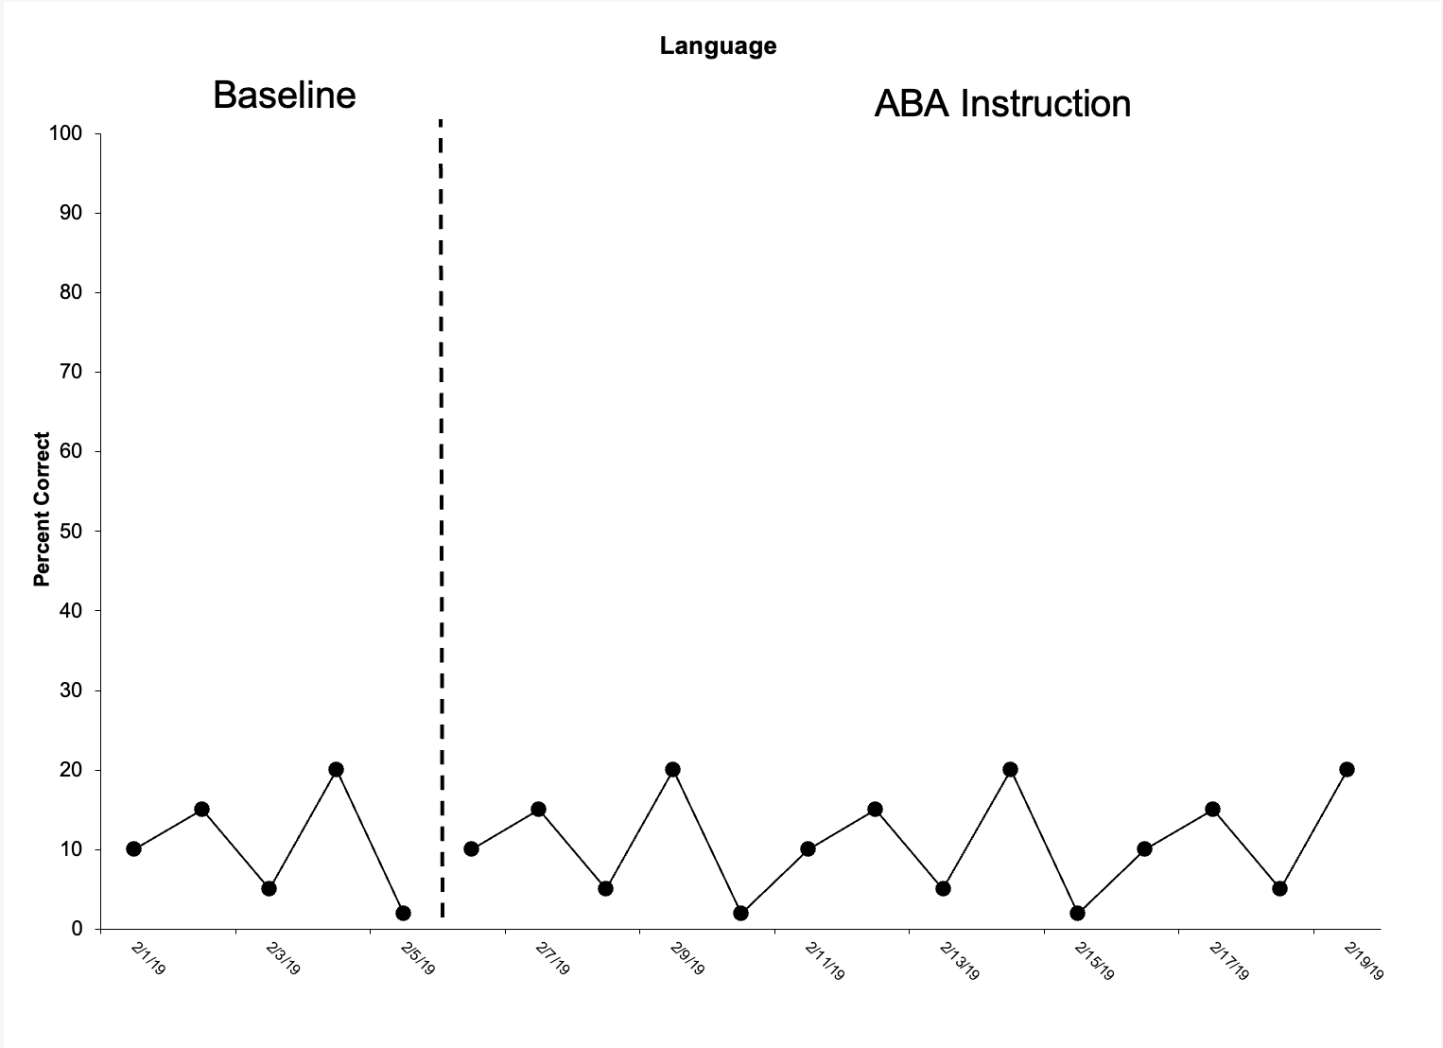
Data Examples

Slide 18
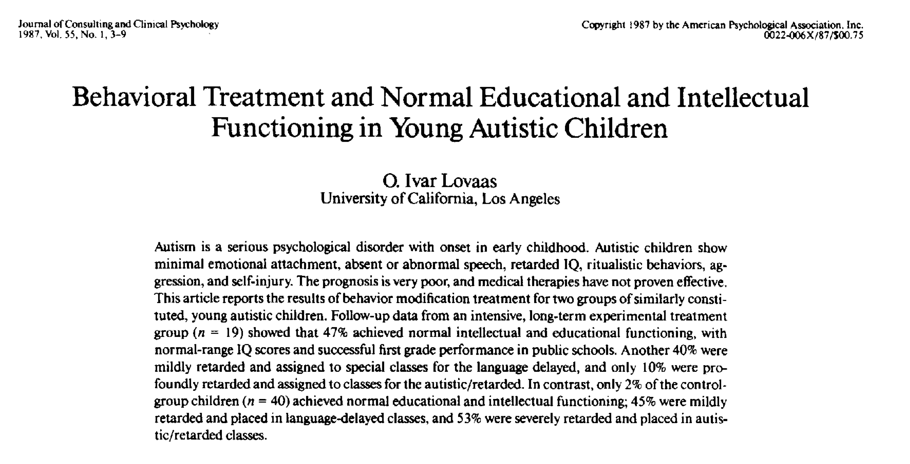

Slide 19
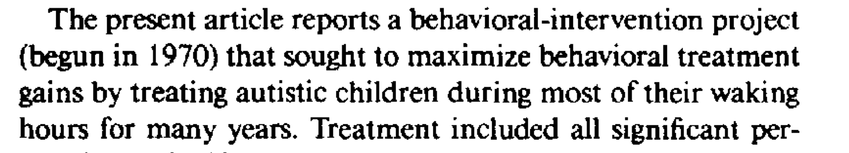
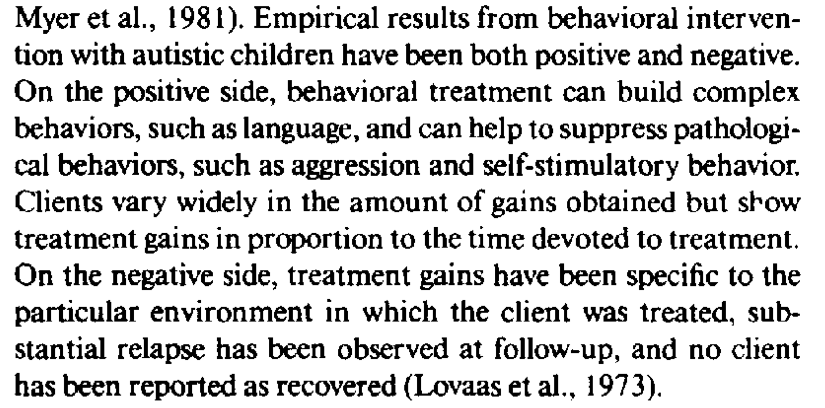

Slide 20
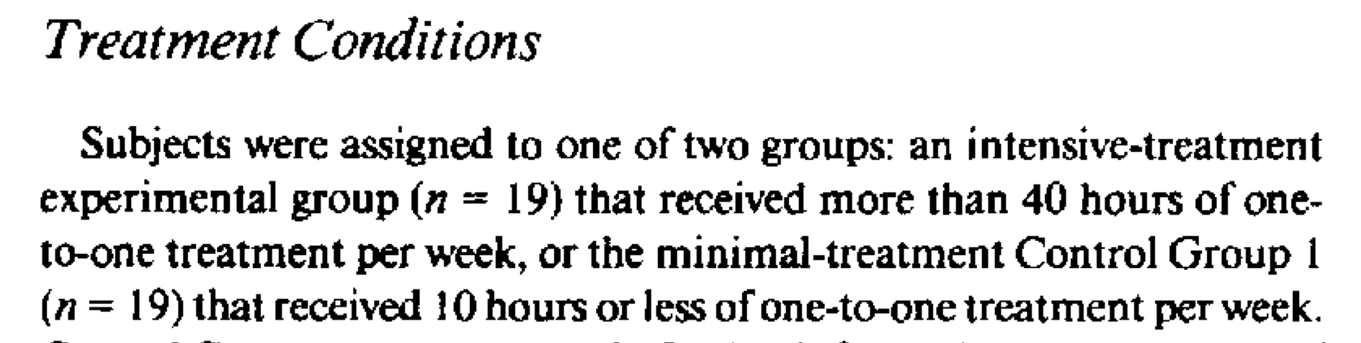

Slide 21
Lovaas et al (1987) results
40 hours ABA Group (n=19)
  9 went from below average IQ to average or above average (M – 107, range 94-120).
    Those 9 entered 1st grade in general education classes
  8 completed 1st grade in “aphasia” classes and IQ in the mild range (M = 70, range 56-95)
  2 were in 1st grade in classes for children with ID/autism and IQs less than (<30)
So…. About half of the intense group saw maximum benefit

Slide 22
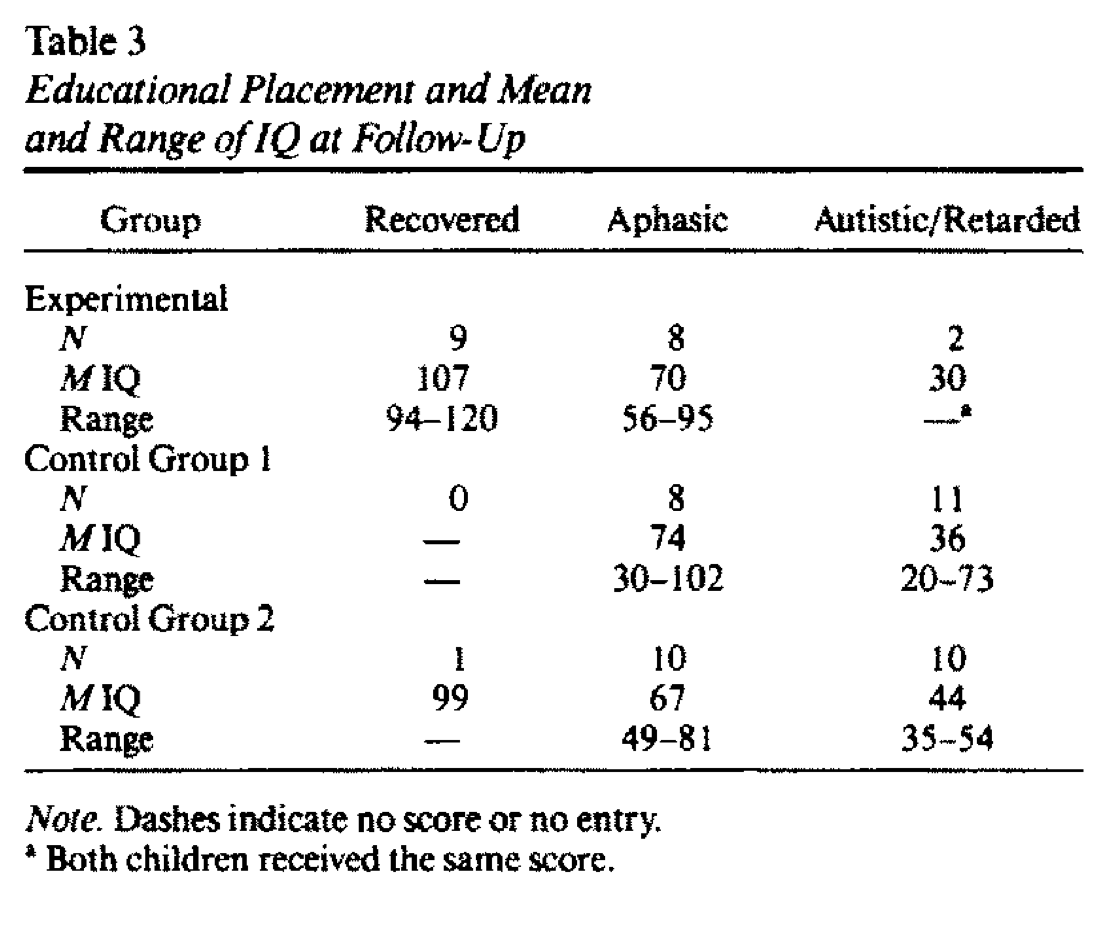
All participants started the same
30-point increase in IQ ABA group to Control 1 and 2
9 kids in general ed in ABA group (9/19)
1 kid in general ed from both control groups (1/40)

Slide 24
Skill Acquisition
Beyond our ability to change thousands of skills in every category of learning that exists
  ABA can increase IQ
  Improve school placement and classroom choice
  Living options
  Academics
  Independence

Slide 25
Behavior Reduction
ABA can increase and decrease behavior.
  When disruptive, interfering, or dangerous behaviors are demonstrated, ABA can reduce those behaviors which prevents them from interfering with learning
In ASD and other developmental disabilities, minor behavioral issues are present in up to 80% of the population
  Mild behaviors
    Non-compliance
    Vocal and motor stereotypy
    Mouthing
    Talking in class

Slide 26
Behavior Reduction
In ASD and other developmental disabilities, severe behavioral issues are present in about 45% of the population
  Severe behaviors
    Self Injury
      Self biting, head banging, skin picking, head hitting, etc.
    Aggression
      Hitting, kicking, biting, pulling hair, etc.
    Pica
    Elopement
These destructive behaviors happen in all settings
  Schools
  Home
  Community

Slide 27
The General Approach
Since the early 1980s, the field has adopted a “Functional” approach to behavior reduction
Determine the reinforcer for a behavior (the “function”)
Topography is not a big consideration
  We do not treat kicking, or hitting, or biting , etc.
  We treat behaviors reinforced by certain things the same way
    Hitting or biting reinforced by access to preferred items are treated the same
    Hitting or biting reinforced by escaping academics is treated differently than those same behavior reinforced by access
    It is the function/reinforcer, not the topography that’s important

Slide 28
The General Approach
Determine the function (the reinforcer)
Use the reinforcer in a treatment
  Reinforce an appropriate behavior that leads to the same reinforcer
    “Replacement behaviors”
    Functional Communication Training (FCT)
    Differential Reinforcement arrangements (DRO, DRI, DRA)
    Non-contingent Reinforcement (NCR)
None of these are prescribed. Any and all can work effectively. The choice is made by the IBA.

Slide 29
ABA is Considered Best Practice
US Surgeon General
American Psychological Association
American Psychiatric Association
Centers for Disease Control and Prevention (CDC)
Autism Speaks
Autism Society of America
National Autism Center
National Institutes of Mental Health

Slide 30
ABA is Considered Best Practice
Every insurance company in the US-- in every state, mandates coverage for ABA services
Federal funding for ABA in ASD treatment
State-level government funding in all 50 states mandatory for ASD services
  “Medicaid”
The US Federal Law REQUIRES ABA to be used in public schools
  Individuals with Disabilities Education Act (IDEA)
  US Federal Law requires the use of the functional approach to behavioral assessment
Thousands of peer-reviewed research articles

Slide 31
Through the lifespan… and everywhere…
ABA is effective from early intervention (0-3) through older adults (65+)
Direct services
  IBAs supervise IBTs, parents, teaching Staff
Consultation
  IBAs consult with and train parents, teaching staff, rehabilitative staff, etc.
Homes, Centers, Community, Hospitals, Schools, Vocational preparation, Rehab and hospital facilities,

Slide 32
More to come…
Thank you for being here and learning about the approach
This was just a brief and very small over view
For more specific ABA topics and applications, please continue to attend the other presentations. Mine include:
  Behavioral Assessment
  Behavioral Treatments for challenging behavior
  Functional Living Skills

Slide 33
Thanks!
Questions?
mmueller@theIBAO.com

