Slide 1
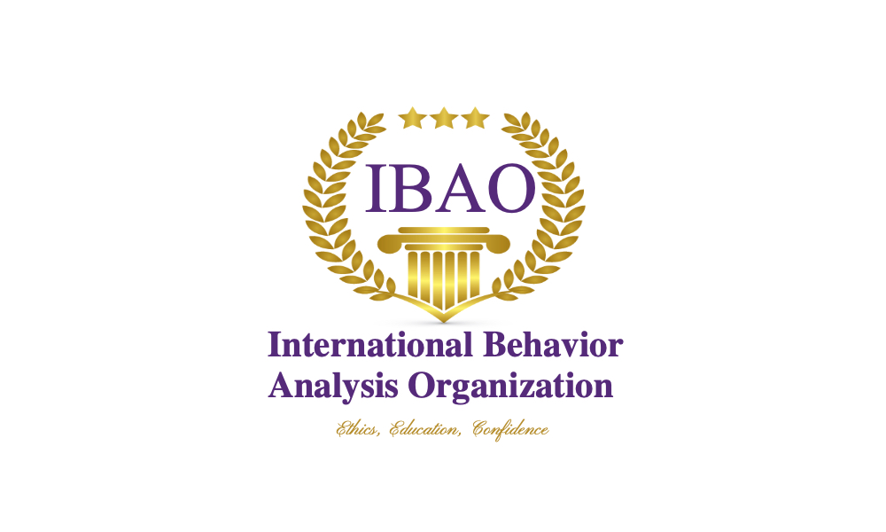

International Behavior Analysis Organization
Promoting International Certification in ABA Around the World
Michael Mueller, Ph.D., BCBA-D, IBA
Executive Director

Slide 2
What is the International Behavior Analysis Organization?
IBAO
IBAO is an international certifying body for those who practice Applied Behavior Analysis.
Started in 2020 to certify behavior professionals around the world
Our goal was to create culturally relevant standards of practice for our certifications

Slide 3
Providing Certifications Around the World
IBAO has 2 certifications
  IBT – Behavior Therapist/Technician
  IBA – Behavior Analyst
IBAO currently has certificants and candidates in 77 different countries
  Australia, Africa, Asia, Europe, North America, South America

Slide 4

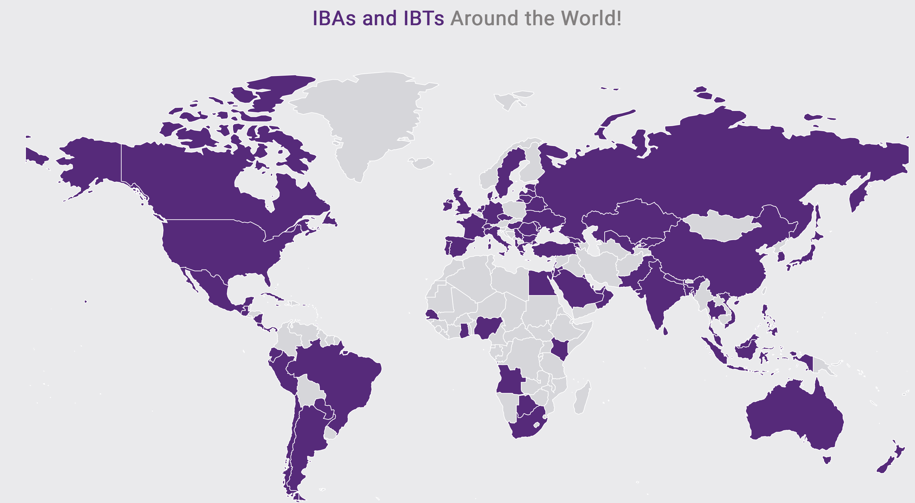
Global Training Standards
Kazakhstan
Kenya
Korea, Republic of
Kuwait
Kyrgyzstan
Latvia
Lebanon
Lithuania
Macao
Malaysia
Malta
Mexico
Moldova
Nepal
Netherlands
New Zealand
Nigeria
Pakistan
Peru
Philippines
Portugal
Puerto Rico
Poland
Qatar
Romania
Russian Federation
Saudi Arabia
Senegal
Singapore
South Africa
Spain
Sri Lanka
Sweden
Switzerland
Thailand
Trinidad and Tobago
Turkey
Ukraine
UAE
United Kingdom
United States
Vietnam
Virgin Islands
Ecuador
Egypt
Estonia
France
Georgia
Germany
Ghana
Greece
Hong Kong
Hungary
India
Indonesia
Ireland
Israel
Italy
Japan
Jordan
Albania
Argentina
Australia
Armenia
Bahamas
Bahrain
Bangladesh
Belarus
Bosnia and Herzegovina
Botswana
Brazil
Bulgaria
Canada
Cayman Islands
Chile
China
Cyprus
Czech Republic
Denmark

Slide 5
Why Are Certifications Important?
Around the world, there are a lack of certified behavior analysts
Community Protection
  Properly trained behavior analysts can be distinguished from improperly trained behavior analysts through certification
  Ethical and professional behavior of the field can be known to the consumers
  Clinical skills will be at a certain level with certified individuals
  Transparency and identifiable behavioral expectations and professional commitments

Slide 6
Why Are Certifications Important?
Professional Acknowledgement!
  Some people have dedicated their careers to ABA
  Time, money, effort
  Some haven’t!
  This is a professional recognition for those who dedicated their lives to ABA

Slide 7
Professional Advisory Board
  Understand obstacles and barriers to certification
  Understand the international needs and DIFFERENCES
      High Costs
      Lack of Translations
      Few test centers required for taking the exam
      High costs of exams – travel, hotel, meals, risk, etc.
      Lack of educational training options – university programs
      Educational systems different around the world
      Lack of Supervisors

Slide 8
Professional Advisory Board
  Currently, 90 behavior analysts from 45 countries
    Country and regional representatives
    Ethics Committee
    Accreditation Committee
    Approved Content Provider Review Committee
    Exam Review Committee
    Social Media Committee
    Committees by language

Slide 9
Document Translations
English
German
French
Portuguese
Spanish
Arabic
Hindi
Turkish
Japanese
Filipino
Romanian
Ukrainian
Vietnamese
Chinese/Mandarin
Mongolian
Georgian
Russian
Hungarian
Italian
Italian
French
Hungarian
Lithuanian
Romanian
Turkish
English
Arabic
Portuguese
Russian
Japanese
Spanish
Exam Translations

Slide 10
Examination
Free
Free re-exam
No Test Centers- Taken anywhere candidate choses*
Any day and any time of candidate’s choosing
Record and Review Proctoring

Slide 11
Lack of Educational Training Options
Previous certification board required education to come only from credit-bearing institutions (i.e., colleges and universities).
  Very difficulty to convince a university to add courses, hire faculty, add a program
  Selling classes requires a market of potential students
    Without credentialed professionals, the market and the profession is very difficult to define
IBAO solutions
  Allow non-credit bearing organizations and individuals to deliver the content
    Individuals, ABA Organizations, Providers
  If the instructors are well qualified, it should not matter if they work for a university or a practitioner organization – certifications are practitioner certifications
  When there are more certified professionals and the field can be defined by this, colleges and universities will see more value in expanding their course catalogs

Slide 12
IBAO Providers
200+ Approved Content Providers
175 Approved CEU Providers
16 Different Languages

Slide 13
Kazakhstan
Academy of Behavior Analysis
  Zhanna Kaliyeva, BCBA, IBA
    Kazakh and Russian

Slide 14
International Behavior Analyst (IBA)
Masters or Experience Route
270 Hours of Required Educational Objectives
1000 Hours of Practice
50 Hours of Supervision
2 Candidate Skills Tests
12 CEUs – 2 Ethics, 2 Cultural, 2 Supervision, 6 General ABA Topics
IBA Exam- 150-item Online, Record and Review
Post Certification Mentorship
Post Certification CEUs 24 in 2-year Cycle 4, 4, 4, 12

Slide 15
International Behavior Therapist (IBT)
High School Diploma or Equivalent
40 Hour IBT Training
300 Hours of Practice
10 Hours of Supervision – group, remote
2 Candidate Skills Tests
75 Item IBT Online Exam

Slide 16
Required CEUs
General ABA Topics
Ethics
Supervision
Cultural
  Broad range of topics that include regional or national difference, religion, race, gender, sexuality, neurodiversity, and non-clinical practice issues and their intersection with ABA

Slide 17
Ethics
Aspirational Guidelines
Not a Black and White “Code”
When in doubt, IBAO has an Ethical Problem-Solving Model

Slide 18
Why an International Standard?
Lack of appropriate autism and Developmental Disabilities awareness and information around the world
Lack of understanding of ABA around the world
Each community is defining this profession. Let’s define it together so that it does not mean 77 different things 5 years from now
Grow the transparent expectation of ethical practice everywhere so the global community knows who we are and what we are not
Telehealth
Practicing in multiple countries
International ethics and expectations formed by the international community

Slide 19
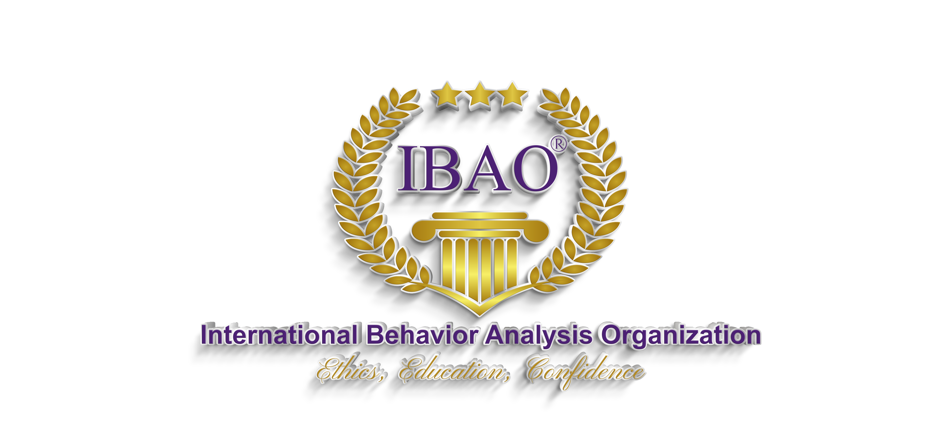
Questions? www.theIBAO.com

